Slide 1

Form Processing in PHP
Dr. Charles Severance
www.wa4e.com
http://www.wa4e.com/code/forms
http://www.wa4e.com/code/forms.zip

Slide 2
PHP Global Variables
Part of the goal of PHP is to make interacting with HTTP and HTML as easy as possible.
PHP processes the incoming HTTP request based on the protocol specifications and drops the data into various super global variables (usually arrays).

Slide 3
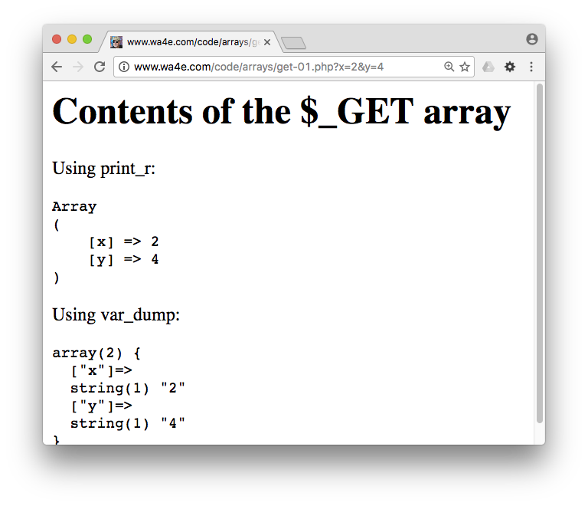
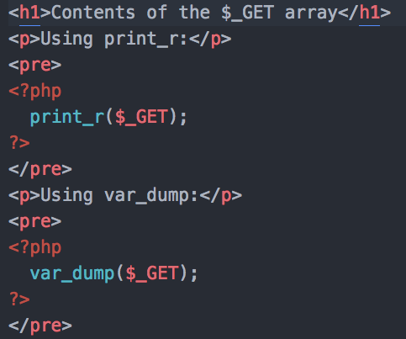
(Review from Arrays)
http://www.wa4e.com/code/arrays/get-01.php

Slide 4


Time
Browser
Web Server
Database Server
DOM
Apache
static
files
MySql
get-01.php?x=2
Parse
Request
Parse
Response
$_GET
PHP
php
code
ind.php
JavaScript
RRC/HTTP
SQL

Slide 5
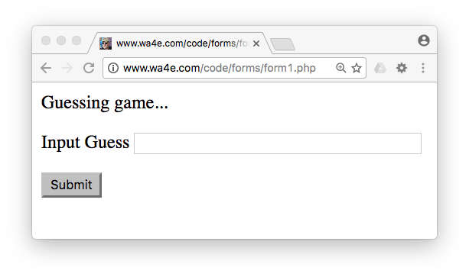
Forms – User Input / Action
<p>Guessing game...</p>
<form>
<p><label for="guess">Input Guess</label>
<input type="text" name="guess" id="guess"/></p>
<input type="submit"/>
</form>
http://www.wa4e.com/code/forms/form1.php

Slide 6
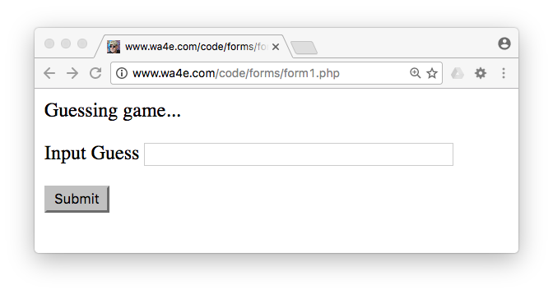


Forms Submit Data
form1.php
<p>Guessing game...</p>
<form>
<p><label for="guess">Input Guess</label>
<input type="text" name="guess" id="guess"/></p>
<input type="submit"/>
</form>

Slide 7
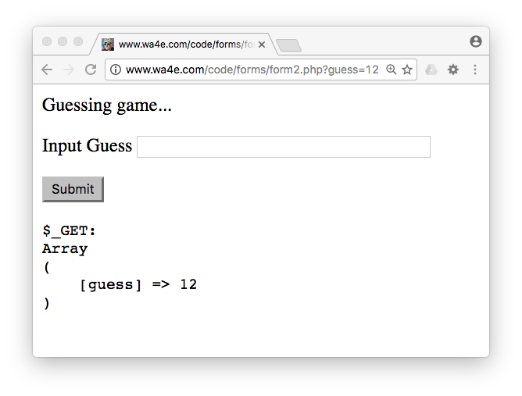
<p>Guessing game...</p>
<form>
<p><label for="guess">Input Guess</label>
<input type="text" name="guess" id="guess"/></p>
<input type="submit"/>
</form>
<pre>
$_GET:
<?php
print_r($_GET);
?>
</pre>
form2.php

Slide 8
Using GET and POST with Forms

Slide 9
Time
Browser
Web Server
Database Server
DOM
Apache
static
files
MySql
Parse
Request
Parse
Response
$_POST
PHP
php
code
form1.php
JavaScript
RRC/HTTP
SQL

Slide 10
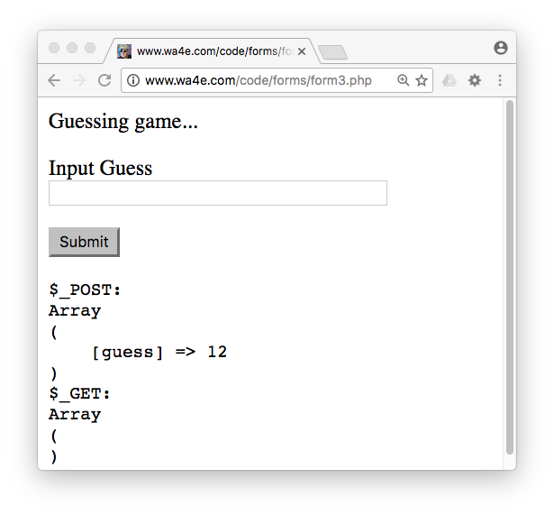
<p>Guessing game...</p>
<form method="post">
<p><label for="guess">Input Guess</label>
<input type="text" name="guess" size="40" id="guess"/></p>
<input type="submit"/>
</form>
<pre>
$_POST:
<?php
print_r($_POST);
?>
$_GET:
<?php
print_r($_GET);
?>
</pre>
form3.php

Slide 11
Forms GET vs. POST
Two ways the browser can send parameters to the web server
    GET - Parameters are placed on the URL which is retrieved.
    POST - The URL is retrieved and parameters are appended to the request in the the HTTP connection.

Slide 12
Passing Parameters to The Server
GET /form1.php?guess=42
Accept: text/html
User-Agent: Lynx/2.4 libwww/2.14
Web Server
HTTP
Request
POST /form3.php
Accept: text/html
User-Agent: Lynx/2.4 libwww/2.14
Content-type: application/x-www-form-urlencoded
Content-length: 13
guess=42
Browser
<input type="text" name="guess" id="yourid" />

Slide 13
Time
Browser
Web Server
Database Server
DOM
Apache
static
files
MySql
Parse
Request
Parse
Response
$_POST
PHP
php
code
form3.php
JavaScript
RRC/HTTP
SQL

Slide 14
Rules of the POST/GET Choice
POST is used when data is being created or modified.
GET is used when your are reading or searching things.
Web search spiders will follow GET URLs but generally not POST URLs.
GET URLs should be “idempotent” - the same URL should give the “same thing” each time you access it.
GET has an upper limit of the number of bytes of parameters and values (think about 2K).

Slide 15
HTML Input Types

Slide 16
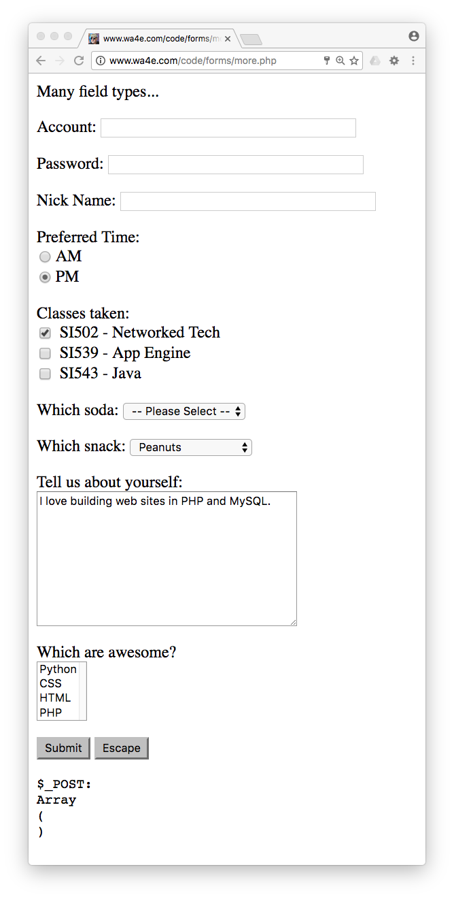
Other Input Types
Text
Password
Radio Button
Check Box
Select / Drop-Down
Textarea
http://www.wa4e.com/code/forms/more.php

Slide 17
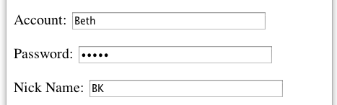
<p>Many field types...</p>
<form method="post" action="more.php">
<p><label for="inp01">Account:</label>
<input type="text" name="account" id="inp01" size="40" ></p>
<p><label for="inp02">Password:</label>
<input type="password" name="pw" id="inp02" size="40" ></p>
<p><label for="inp03">Nick Name:</label>
<input type="text" name="nick" id="inp03" size="40" ></p>
more.php
$_POST:
Array
(
[account] => Beth
[pw] => 12345
[nick] => BK
[when] => pm
...
)

Slide 18
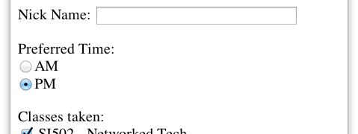
more.php
<p>Preferred Time:<br/>
<input type="radio" name="when" value="am">AM<br>
<input type="radio" name="when" value="pm" checked>PM</p>
$_POST:
Array(
...
[nick] => BK
[when] => pm
[class] => si502
...
)

Slide 19
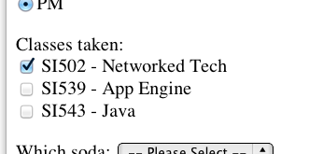
<p>Classes taken:<br/>
<input type="checkbox" name="class1" value="si502" checked>
SI502 - Networked Tech<br>
<input type="checkbox" name="class2" value="si539">
SI539 - App Engine<br>
<input type="checkbox" name="class3">
SI543 - Java<br> </p>
$_POST:
Array(
...
[when] => pm
[class1] => si502
[soda] => 0
...
)
$_POST:
Array(
...
[when] => pm
[class3] => on
[soda] => 0
...
)

Slide 20
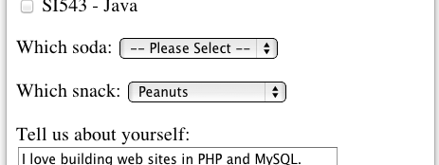
<p><label for="inp06">Which soda:
<select name="soda" id="inp06">
<option value="0">-- Please Select --</option>
<option value="1">Coke</option>
<option value="2">Pepsi</option>
<option value="3">Mountain Dew</option>
<option value="4">Orange Juice</option>
<option value="5">Lemonade</option>
</select>
</p>
more.php
$_POST:
Array(
...
[class] => si502
[soda] => 0
[snack] => peanuts
...
)
The values can be any string, but numbers are used quite often.

Slide 21
more.php
<p><label for="inp07">Which snack:
<select name="snack" id="inp07">
<option value="">-- Please Select --</option>
<option value="chips">Chips</option>
<option value="peanuts" selected>Peanuts</option>
<option value="cookie">Cookie</option>
</select>
</p>
$_POST:
Array(
...
[class] => si502
[soda] => 0
[snack] => peanuts
...
)

Slide 22
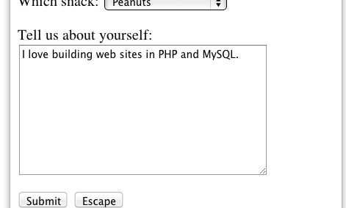
more.php
<p><label for="inp08">Tell us about yourself:<br/>
<textarea rows="10" cols="40" id="inp08" name="about">
I love building web sites in PHP and MySQL.
</textarea>
</p>
$_POST:
Array(
...
[about] => I love building web sites in PHP and MySQL.
[dopost] => Submit
...
)

Slide 23
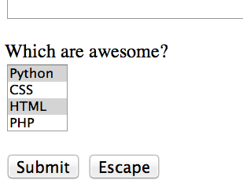
<p><label for="inp09">Which are awesome?<br/>
<select multiple="multiple" name="code[]" id="inp09">
<option value="python">Python</option>
<option value="css">CSS</option>
<option value="html">HTML</option>
<option value="php">PHP</option>
</select>
more.php
$_POST:
Array(
...
[code] => Array
(
[0] => css
[1] => html
)
[dopost] => Submit
...
)

Slide 24
more.php
<p>
<input type="submit" name="dopost" value="Submit"/>
<input type="button"
onclick="location.href='http://www.wa4e.com/'; return false;"
value="Escape">
</p>
$_POST:
Array(
...
[dopost] => Submit
...
)
On submit input types, the text is both in the UI and in $_POST so we tend to look for the key, not the value.

Slide 25
HTML 5 Input Types

Slide 26
HTML5 Input Types
HTML5 defines new input types
Not all browsers support all input types
They fall back to type="text"
http://www.w3schools.com/html/html5_form_input_types.asp

Slide 27
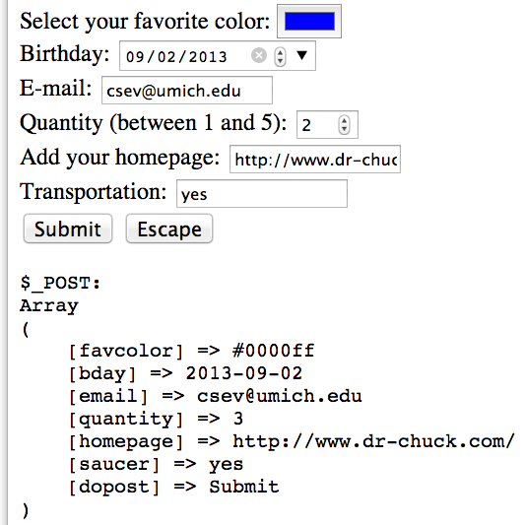
Select your favorite color:
<input type="color" name="favcolor" value="#0000ff"><br/>
Birthday:
<input type="date" name="bday" value="2013-09-02"><br/>
E-mail:
<input type="email" name="email"><br/>
Quantity (between 1 and 5):
<input type="number" name="quantity"
min="1" max="5"><br/>
Add your homepage:
<input type="url" name="homepage"><br>
Transportation:
<input type="flying" name="saucer"><br>
Validation happens when you press submit.
http://www.wa4e.com/code/forms/html5.php

Slide 28
Processing Form Data and HTML Injection

Slide 29
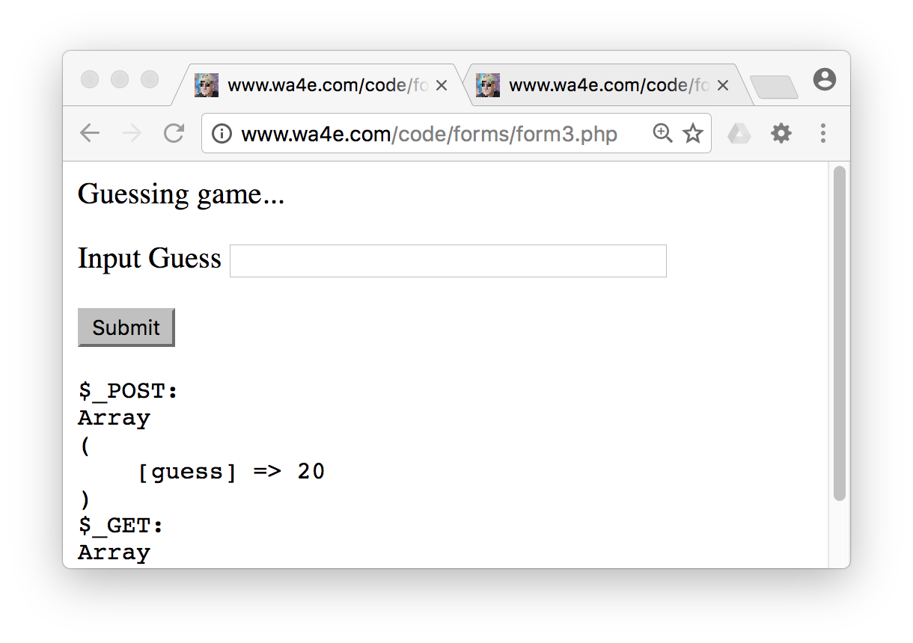
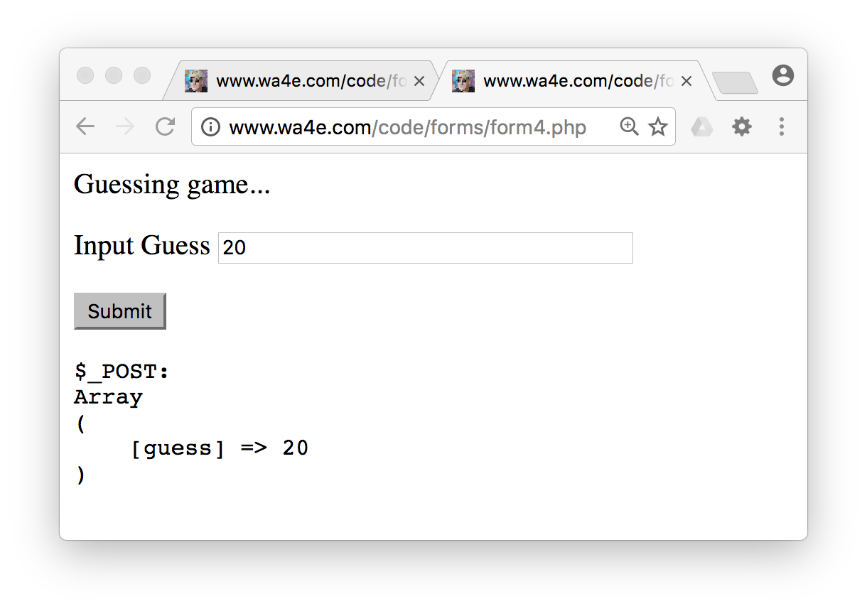
Persisting Form Data
When we submit forms and there is an error, we just expect that the data will remain in the form when the page is redisplayed.
The application needs to make sure to put the previous values back into the form.

Slide 30
<?php
$oldguess = isset($_POST['guess']) ? $_POST['guess'] : '';
?>
<p>Guessing game...</p>
<form method="post">
<p><label for="guess">Input Guess</label>
<input type="text" name="guess" id="guess"
size="40" value="<?= $oldguess ?>"/></p>
<input type="submit"/>
</form>
“Persisting”
Form Data
Across
Requests
form4.php
<?= $oldguess ?>
<?php echo($oldguess); ?>
Review: Ternary Operation

Slide 31
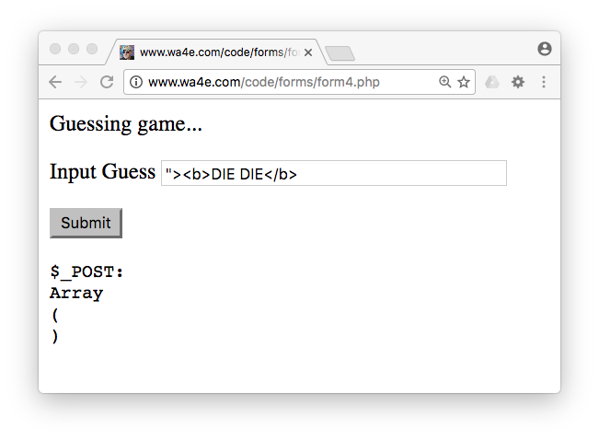
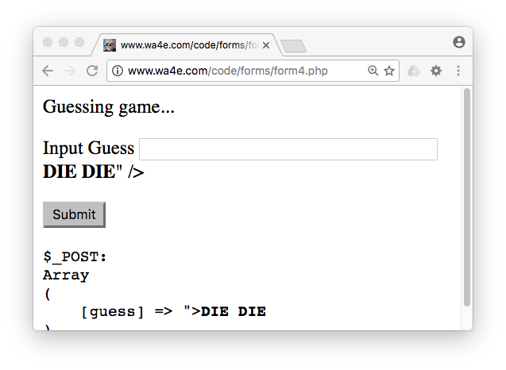
Hygiene Alert!
What happens when we use an HTML character in a form field value?

Slide 32
<form method="post">
<p><label for="guess">Input Guess</label>
<input type="text" name="guess" id="guess
size="40" "value=""><b>DIE DIE</b>" /></p>
<input type="submit"/>
</form>
form4.php

Slide 33
To The Rescue: htmlentities()
<form method="post">
<p><label for="guess">Input Guess</label>
<input type="text" name="guess" id="guess"
size="40" value="<?= htmlentities($oldguess) ?>"/></p>
<input type="submit"/>
</form>
form5.php

Slide 34
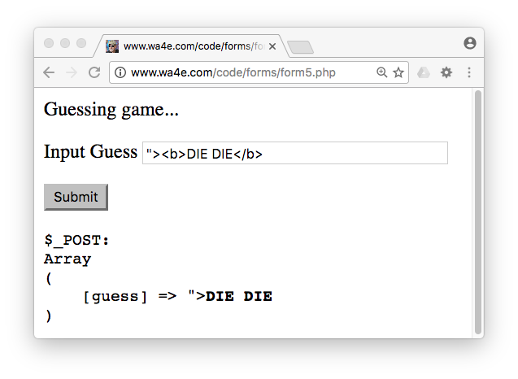
<form method="post">
<p><label for="guess">Input Guess</label>
<input type="text" name="guess" id="guess"
size="40" value="<?= htmlentities($oldguess) ?>"/></p>
<input type="submit"/>
</form>
<input type="text" name="guess" id="guess"
value="&quot;&gt;&lt;b&gt;DIE DIE&lt;/b&gt;" /></p>

Slide 35
Guessing Game

Slide 36
Time
Browser
Web Server
Database Server
DOM
Apache
static
files
MySql
Parse
Request
Parse
Response
$_POST
PHP
php
code
form3.php
JavaScript
RRC/HTTP
SQL

Slide 37
Incoming Data Validation
Making sure all user data is present and the correct format before proceeding
  Non-empty strlen($var) > 0
  A number is_numeric($var)
  An email address strpos($var, '@') > 0
  Or filter_var($var, FILTER_VALIDATE_EMAIL) !== false
  ....

Slide 38
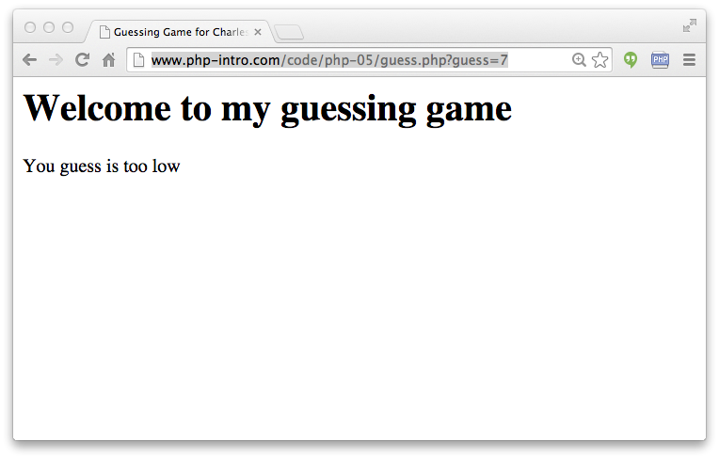
http://www.wa4e.com/code/forms/guess.php?guess=7

Slide 39
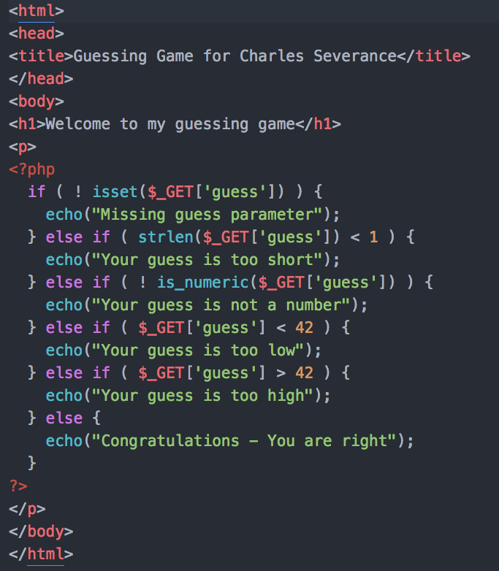
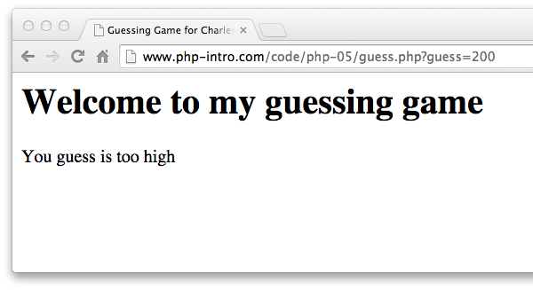
http://www.wa4e.com/code/forms/guess.php?guess=200

Slide 40
Model View Controller (MVC)

Slide 41
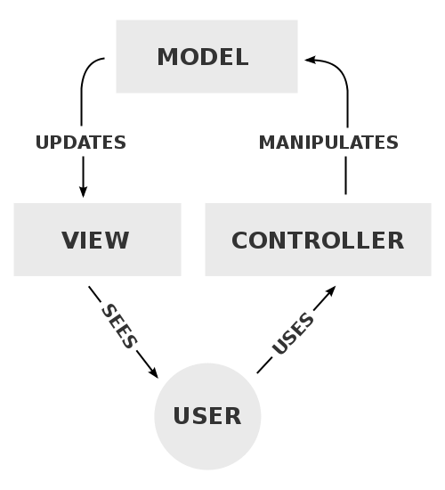
Model-View-Controller
A model that defines the elements of a web application and how they interact
View – Produces output
Model – Handles data
Controller – Orchestration / Routing
https://en.wikipedia.org/wiki/Model-view-controller

Slide 42
Pattern: Processing POST Data
Many patterns for handling POST data
No “rules”, just “suggestions”
<?php
$guess = '';
$message = false;
if ( isset($_POST['guess']) ) {
// Trick for integer / numeric parameters
$guess = $_POST['guess'] + 0;
if ( $guess == 42 ) {
$message = "Great job!";
} else if ( $guess < 42 ) {
$message = "Too low";
} else {
$message = "Too high...";
}
}
?>
<html>
<head>
<title>A Guessing game</title>
</head>
<body style="font-family: sans-serif;">
<p>Guessing game...</p>
<?php
if ( $message !== false ) {
echo("<p>$message</p>\n");
}
?>
<form method="post">
<p><label for="guess">Input Guess</label>
<input type="text" name="guess" id="guess" size="40"
<?php echo 'value="' . htmlentities($guess) . '"';
?>
/></p>
<input type="submit"/>
</form>
</body>
Completely process incoming data (if any) - produce no output
Produce the page output
What about frameworks?
guess_mvc.php

Slide 43
<?php
$oldguess = '';
$message = false;
if ( isset($_POST['guess']) ) {
// Trick for integer / numeric parameters
$oldguess = $_POST['guess'] + 0;
if ( $oldguess == 42 ) {
$message = "Great job!";
} else if ( $oldguess < 42 ) {
$message = "Too low";
} else {
$message = "Too high...";
}
}
?>
<html>
<head>
<title>A Guessing game</title>
</head>
<body style="font-family: sans-serif;">
<p>Guessing game...</p>
<?php
if ( $message !== false ) {
echo("<p>$message</p>\n");
}
?>
<form method="post">
<p><label for="guess">Input Guess</label>
<input type="text" name="guess" id="guess" size="40"
value="<?= htmlentities($oldguess) ?>"/></p>
<input type="submit"/>
</form>
</body>
Model
Context
Controller
View
guess_mvc.php

Slide 44
<?php
$oldguess = '';
$message = false;
if ( isset($_POST['guess']) ) {
// Trick for integer / numeric parameters
$oldguess = $_POST['guess'] + 0;
if ( $oldguess == 42 ) {
$message = "Great job!";
} else if ( $oldguess < 42 ) {
$message = "Too low";
} else {
$message = "Too high...";
}
}
?>
<html>
<head>
<title>A Guessing game</title>
</head>
<body style="font-family: sans-serif;">
<p>Guessing game...</p>
<?php
if ( $message !== false ) {
echo("<p>$message</p>\n");
}
?>
<form method="post">
<p><label for="guess">Input Guess</label>
<input type="text" name="guess" id="guess" size="40"
value="<?= htmlentities($oldguess) ?>"/></p>
<input type="submit"/>
</form>
</body>
No
HTML
Context
Controller
No
Database
guess_mvc.php

Slide 45
<?php
$guess = '';
$message = false;
if ( isset($_POST['guess']) ) {
// Trick for integer / numeric parameters
$guess = $_POST['guess'] + 0;
if ( $guess == 42 ) {
$message = "Great job!";
} else if ( $guess < 42 ) {
$message = "Too low";
} else {
$message = "Too high...";
}
}
?>
<html>
<head>
<title>A Guessing game</title>
</head>
<body style="font-family: sans-serif;">
<p>Guessing game...</p>
<?php
if ( $message !== false ) {
echo("<p>$message</p>\n");
}
?>
<form method="post">
<p><label for="guess">Input Guess</label>
<input type="text" name="guess" id="guess" size="40"
value="<?= htmlentities($oldguess) ?></p>
<input type="submit"/> <input type="submit"/>
</form>
</body>
<?php
$oldguess = '';
$message = false;
if ( isset($_POST['guess']) ) {
// Nifty trick
$oldguess = $_POST['guess'] + 0;
if ( $oldguess == 42 ) {
$message = "Great job!";
} else if ( $oldguess < 42 ) {
$message = "Too low";
} else {
$message = "Too high...";
}
}
?>
<html> ...
guess_mvc.php

Slide 46
<?php
$guess = '';
$message = false;
if ( isset($_POST['guess']) ) {
// Trick for integer / numeric parameters
$guess = $_POST['guess'] + 0;
if ( $guess == 42 ) {
$message = "Great job!";
} else if ( $guess < 42 ) {
$message = "Too low";
} else {
$message = "Too high...";
}
}
?>
<html>
<head>
<title>A Guessing game</title>
</head>
<body style="font-family: sans-serif;">
<p>Guessing game...</p>
<?php
if ( $message !== false ) {
echo("<p>$message</p>\n");
}
?>
<form method="post">
<p><label for="guess">Input Guess</label>
<input type="text" name="guess" id="guess" size="40"
value="<?= htmlentities($oldguess) ?></p>
<input type="submit"/> <input type="submit"/>
</form>
</body>
...
?>
<html>
<head>
<title>A Guessing game</title>
</head>
<body style="font-family: sans-serif;">
<p>Guessing game...</p>
<?php
if ( $message !== false ) {
echo("<p>$message</p>\n");
}
?>
<form method="post">
<p><label for="guess">Input Guess</label>
<input type="text" name="guess" id="guess" size="40"
value="<?= htmlentities($oldguess) ?>"></p>
<input type="submit"/>
</form>
</body>

Slide 47
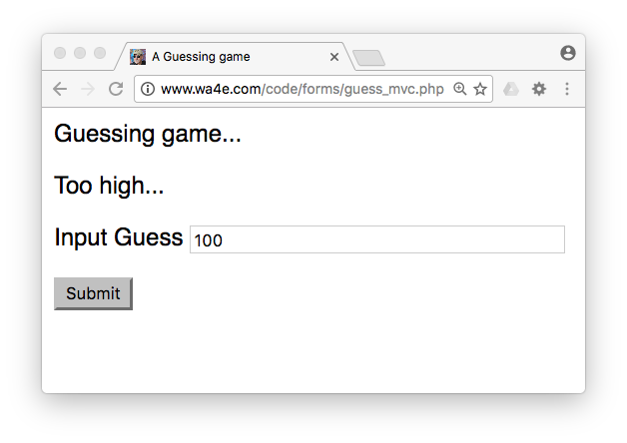
<?php
$oldguess = '';
$message = false;
if ( isset($_POST['guess']) ) {
// Nifty trick
$oldguess = $_POST['guess'] + 0;
if ( $oldguess == 42 ) {
$message = "Great job!";
} else if ( $oldguess < 42 ) {
$message = "Too low";
} else {
$message = "Too high...";
}
}
?>
<html> ...
guess_mvc.php
Note: This code is a little sloppy in terms of its data validation.

Slide 48
<html>
<head>
<title>A Guessing game</title>
</head>
<body style="font-family: sans-serif;">
<p>Guessing game...</p>
<?php
if ( $message !== false ) {
echo("<p>$message</p>\n");
}
?>
<form method="post">
<p><label for="guess">Input Guess</label>
<input type="text" name="guess" id="guess" size="40"
value="<?= htmlentities($oldguess) ?>"></p>
<input type="submit"/>
</form>
</body>
guess_mvc.php

Slide 49
Summary
Forms, $_GET and $_POST
Form fields
New form fields in HTML5
Sanitizing HTML
Data Validation
Model-View-Controller

Slide 50
Acknowledgements / Contributions
These slides are Copyright 2010- Charles R. Severance (www.dr-chuck.com) as part of www.wa4e.com and made available under a Creative Commons Attribution 4.0 License. Please maintain this last slide in all copies of the document to comply with the attribution requirements of the license. If you make a change, feel free to add your name and organization to the list of contributors on this page as you republish the materials.
Initial Development: Charles Severance, University of Michigan School of Information
Insert new Contributors and Translators here including names and dates
Continue new Contributors and Translators here
Notes:
Note from Chuck. Please retain and maintain this page as you remix and republish these materials. Please add any of your own improvements or contributions.

